Slide 1
Transfer learning for Machine reading comprehension
Studying knowledge transfer over bi-directional attention flow networks for reading comprehension

Slide 2
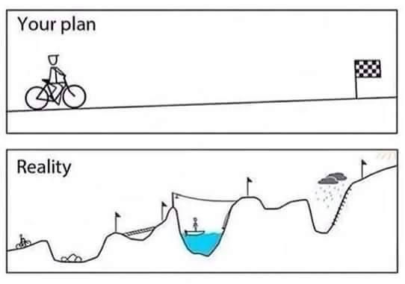
Agenda
Background + Motivation
Machine reading comprehension
Squad dataset
Motivation examples
Transfer learning
Methods
Results

Slide 3
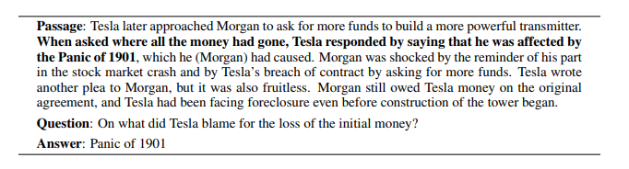
What is machine comprehension?
Given a text passage P
and a question Q,
predict the answer A
using the information in P.

Slide 4
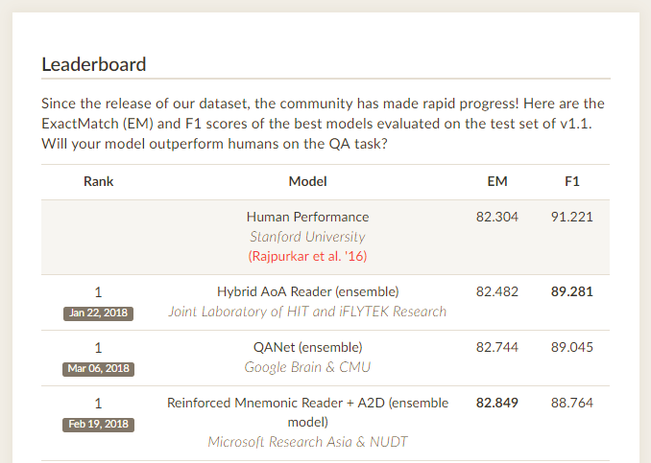
Stanford Squad dataset
100,000 + Questions
Crowdsourced
Corpus: Wikipedia
A is a sub-span of P
Notes:
Types of questions?

Slide 5

Motivation: Examples
Question-Answering chatbot
Car embedded bot
Car manual + services
What should be the tire pressure?
Internet assistant
Browser extension
User asks questions while browsing
Example: blog post
PROBLEM: OTHER DOMAINS DON’T HAVE LUXURY DATASETS LIKE SQUAD!!!

Slide 6
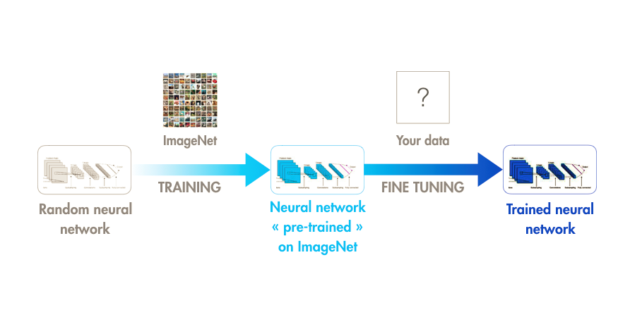
Goal: Transfer knowledge from Squad to other corpora
Inspiration: Computer vision
Train with squad dataset
Fine tune In other domain

Slide 7
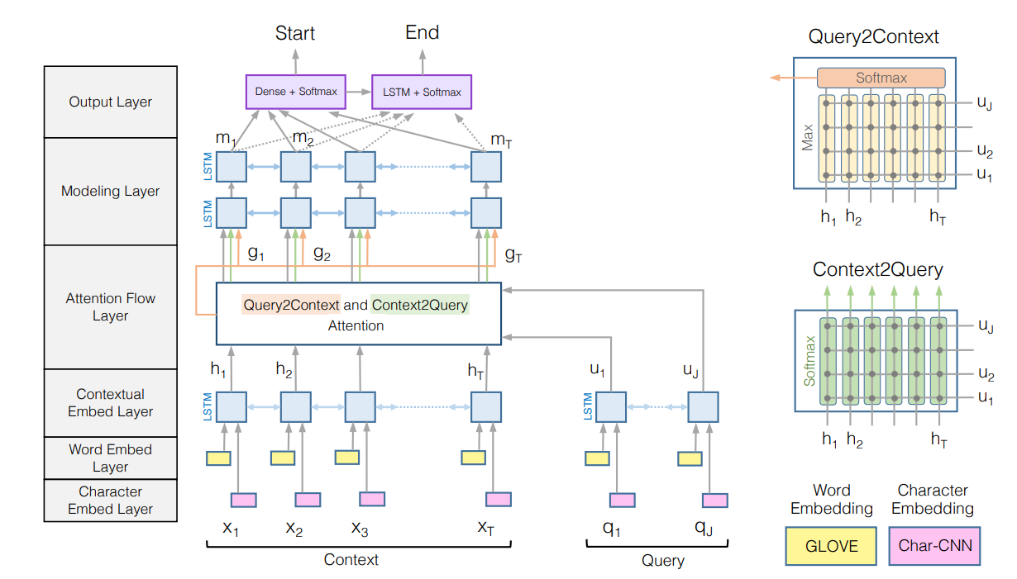
Method: Studying feasibility of transfer learning for machine comprehension
SOURCE DOMAIN
SQUAD DATASET
WIKIPEDIA CONTENT
TARGET DOMAIN
MS-MARCO DATASET
INTERNET CONTENT
ARCHITECTURE
BI-DIRECTIONAL ATTENTION FLOW NETWORK (BI-DAF)
WE USE BETWEEN 0 AND 500 LABELED EXAMPLES
TRAIN BI-DAF ON SQUAD
HARDWARE
NVIDIA K80 GPU
TRAIN ON SQUAD: 16.4 HS
METHOD
FINE-TUNE FOR MS-MARCO EXAMPLES

Slide 8
Results
MODEL | F1 (LR = 0.8) | F1 (LR = 0.5)
R-NET + SQUAD (STATE OF THE ART) | 0.88764 | N/A
BI-DAF + SQUAD (OUR BASE MODEL) | 0.7568401 (0.773) | 0.7407
BI-DAF + MS-MARCO (NO TRANSFER, 500 EXAMPLES) | 0.1102 | N/A
BI-DAF + SQUAD (DIRECT EVALUATION ON MS-MARCO) | 0.5097 | 0.4833
BI-DAF + SQUAD + MS-MARCO (131 EXAMPLES) | 0.54881 | 0.55023
BI-DAF + SQUAD + MS-MARCO (250 EXAMPLES) | 0.55717 | 0.56829
BI-DAF + SQUAD + MS-MARCO (500 EXAMPLES) | 0.56014 | 0.59145

Slide 9
CONCLUSIONS
ANALYSIS
NEXT STEPS
ACCURACY / F1: GOOD START BUT CAN BE IMPROVED!
IS IT THE KIND OF QUESTION? NO! F1 SCORES ARE SIMILAR ACROSS QUESTION CATEGORIES
NUMERIC (28.4%)
DESCRIPTION (52.6%)
LOCATION (5.7%)
LOW PERFORMANCE:
INFORMAL WRITING, SOCIAL NETWORKS, NEWS, SLANG!
WHY QUESTIONS
QUESTIONS WITH NO ANSWER
IN-PROGRESS: WEB NAVIGATION ASSISTANT CHAT BOT WITH MODEL
STUDY NOT FREEZING EMBEDDING LAYER DURING FINE TUNING
REPEAT FOR OTHER NON ATTENTION-BASED ARCHITECTURES SUCH AS R-NET
REPEAT FOR ENSEMBLES USED IN STATE OF THE ART

Slide 10
Questions?

